Slide 1


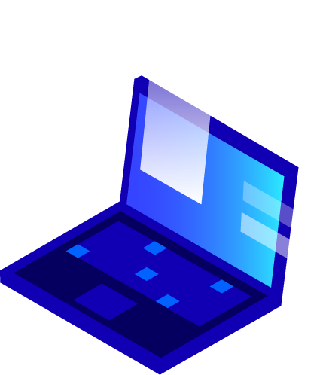


Sign Gloves IoT and 3D Intelligent System Project Andrea Grandi Daniele Vellani Luca Montagnani

Slide 2
Index
1. Project presentation
1.1. Introduction
1.2. Objectives
1.3. Structure
1.4. Control Unit
2. Cloud and Communications
2.1. Web Application
2.2. Mobile Application
3. Machine Learning
3.1. Motivation
3.2. Model
3.3. Possible Improvements

Slide 3
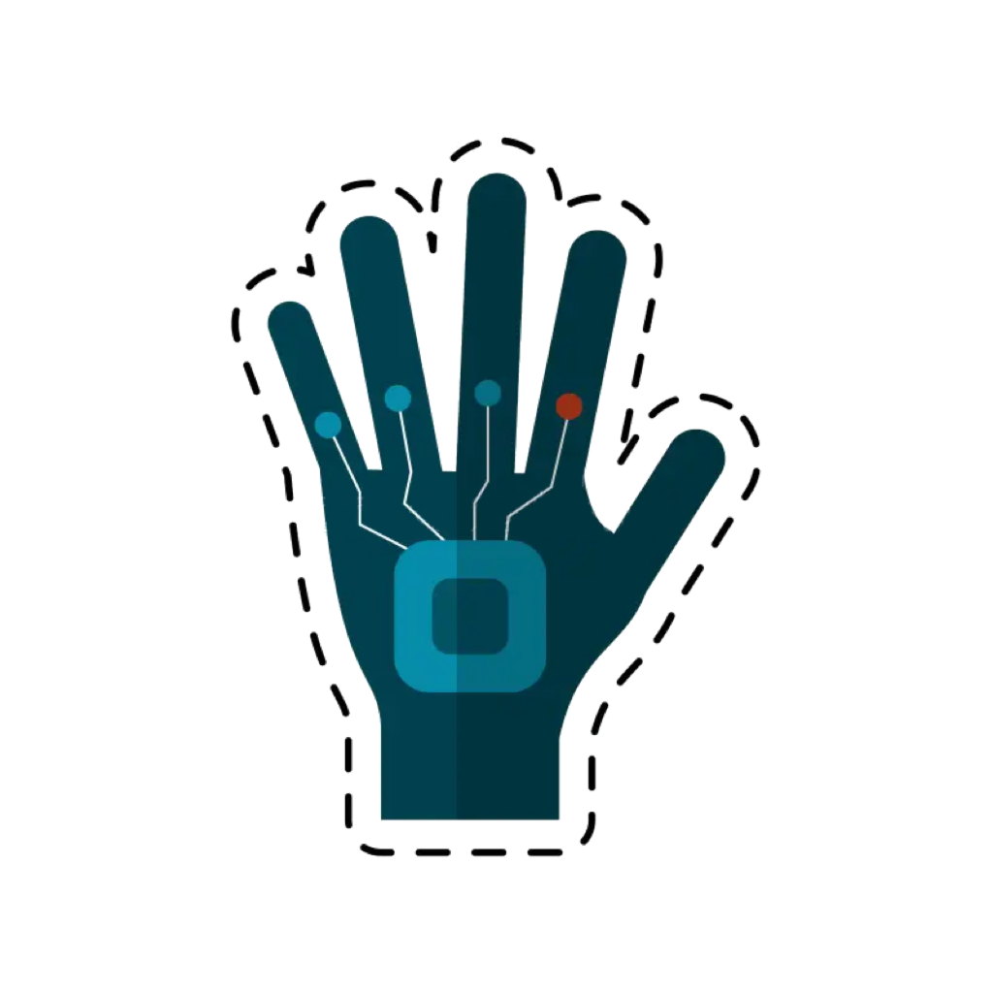
1.1 Introduction
Speech is the easiest way for communication in the world.
It becomes difficult for speech-impaired people to communicate with other people as they use sign language for communication.
When a speech-impaired person communicates with non-deaf person, the bridge gap between them is too much to fill …
In Italy, the Deaf community that uses Italian Sign Language (LIS) comprises approximately 40,000 people
Source: Università Ca’ Foscari Venezia

Slide 4
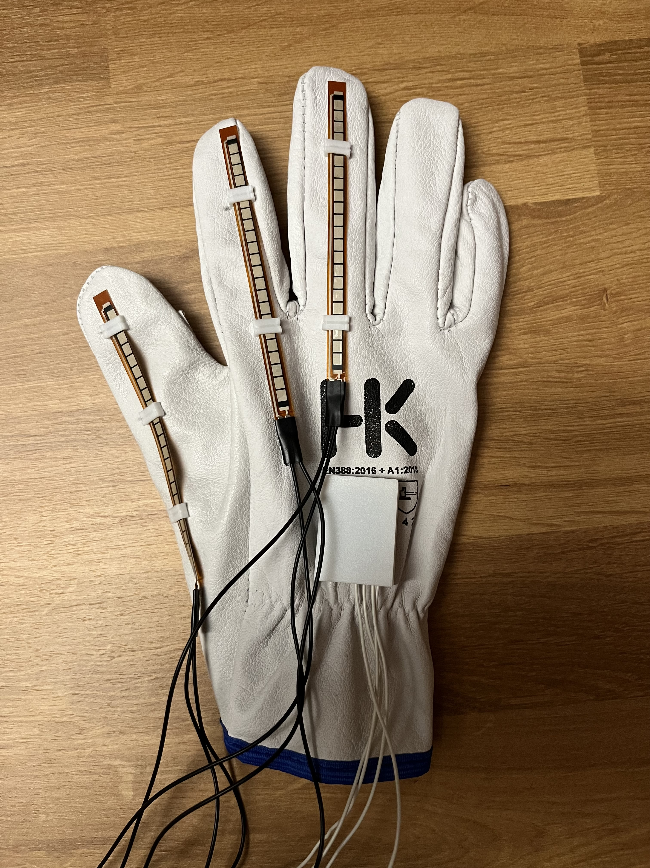
Solution
Sign Glove is capable of addressing this issue by facilitating communication between deaf and mute individuals with those who are not.

Slide 5
1.2 Objectives
Our system can convert sign language in audio for interactions between deaf people and non-deaf people.
Using sensors (flex sensors, microphone, etc.), it can translate sign language.
But our project goes beyond mere translation …
Additionally, it can detect potentially hazardous situations in the environment and alert others through the gloves.

Slide 6
Roadmap
Idea
Glove Design
Glove Creation
1
3
5
2
4
6
Software Design
Implementation
Testing

Slide 7
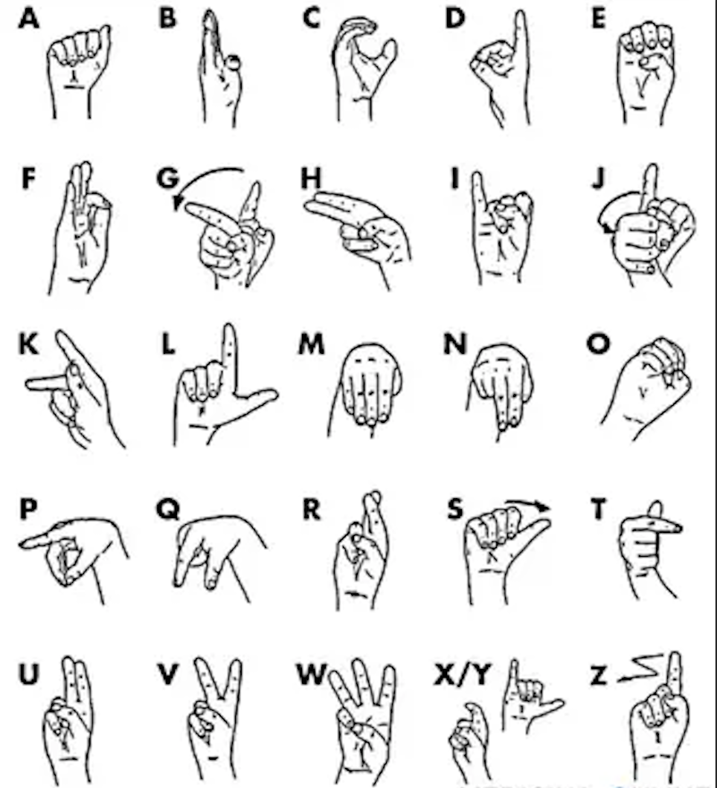
LIS Sign Language

Slide 8
1.3 Structure
Controller: Arduino/Esp32 – C++
Android App: MIT App Inventor
Web App: Flask – Python
Predictions: Prophet
Comunications: MQTT/HTTP
Database: SQLite/CouchDB

Slide 9
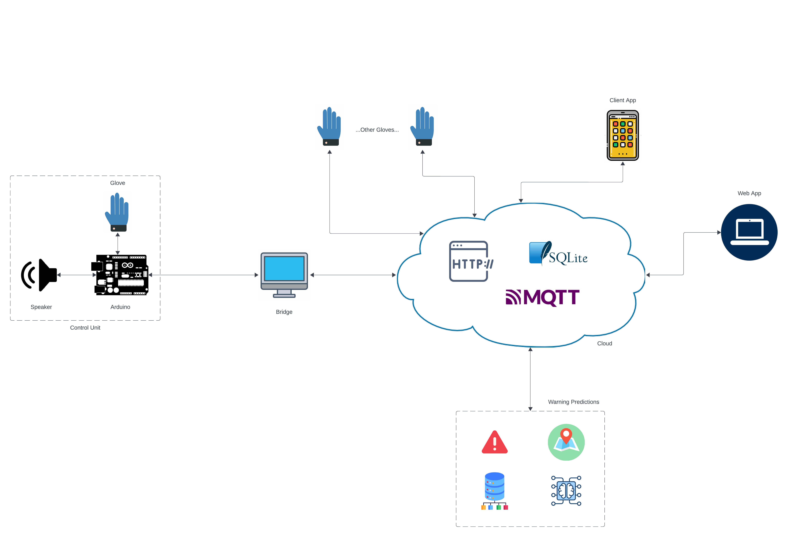



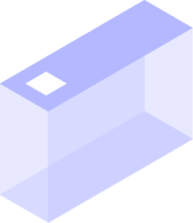

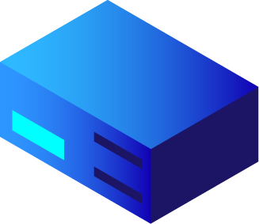



Diagram
Three main parts:
1. Control Unit
2. Cloud
3. Predictions

Slide 10
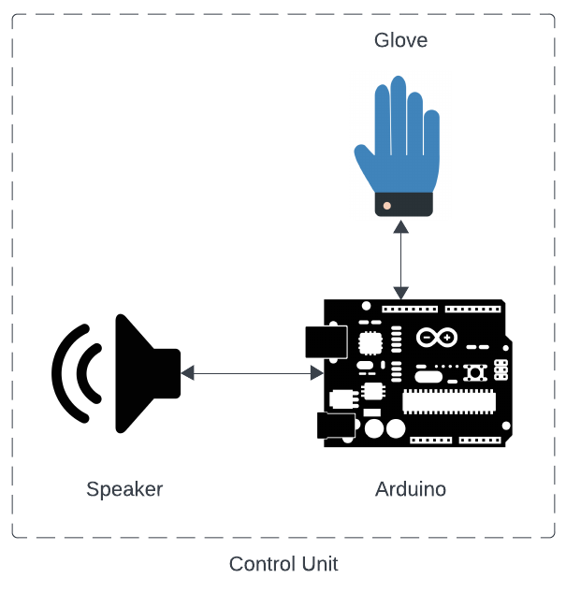
1.4 Control Unit
The control unit manages the sensor and actuator components of the glove.
It is also responsible for bridging between Arduino and the Cloud.

Slide 11
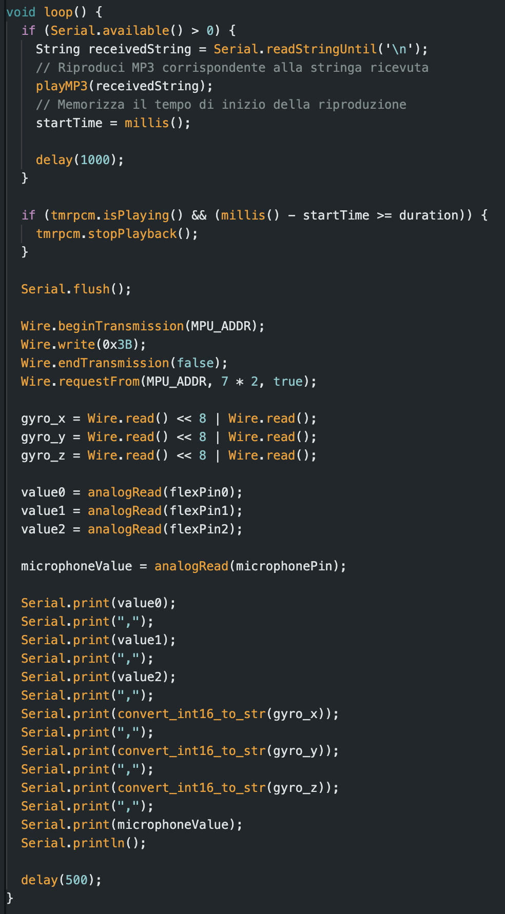
Microcontroller
The main microcontroller (Arduino Uno) is responsible for gathering sensor information and sending it to the bridge, where the translation process (via machine learning) takes place.
Finally, with the data received from the serial connection, the microcontroller emits the sound associated with the corresponding letter through a speaker (actuator).

Slide 12
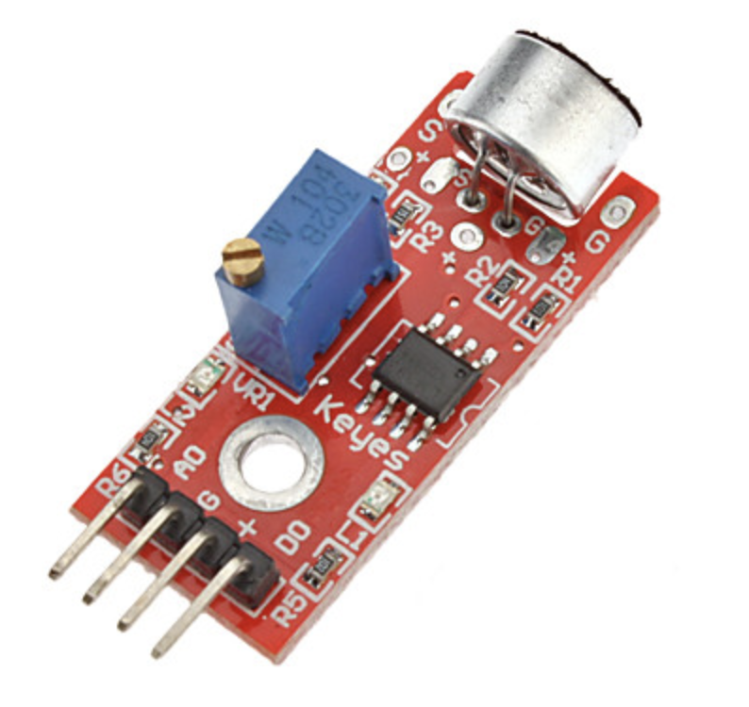
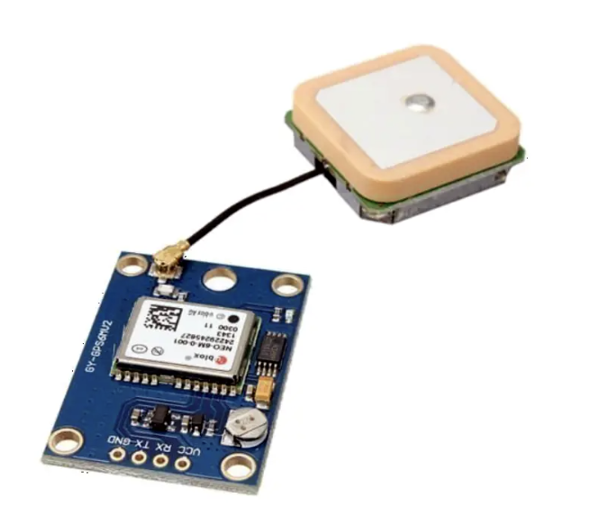
Furthermore, it is primarily responsible for receiving acoustic signals in the surrounding environment.
In fact, through a microphone, it is capable of recognizing, with a Speech Recognition component, a series of target sounds and words.
When it recognizes these sounds, it sends a signal to the bridge containing various data, including the position of the glove indicated by a built-in GPS.

Slide 13
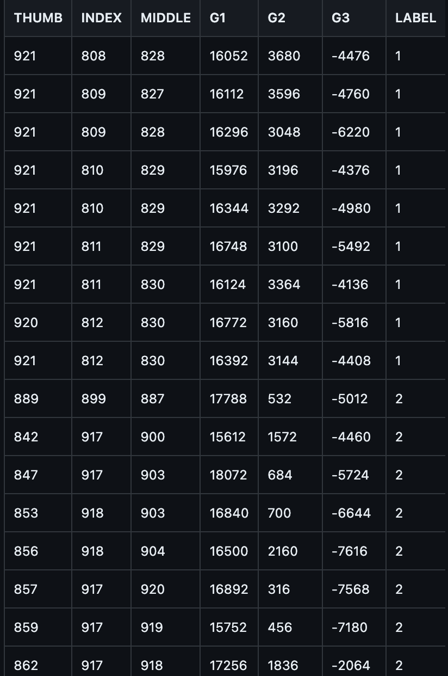
The data collected by the microcontroller is processed by the bridge.
To translate a hand position into a letter, it employs machine learning.
When it receives the data string from the microcontroller, it queries the model which returns a predicted letter.

Slide 14
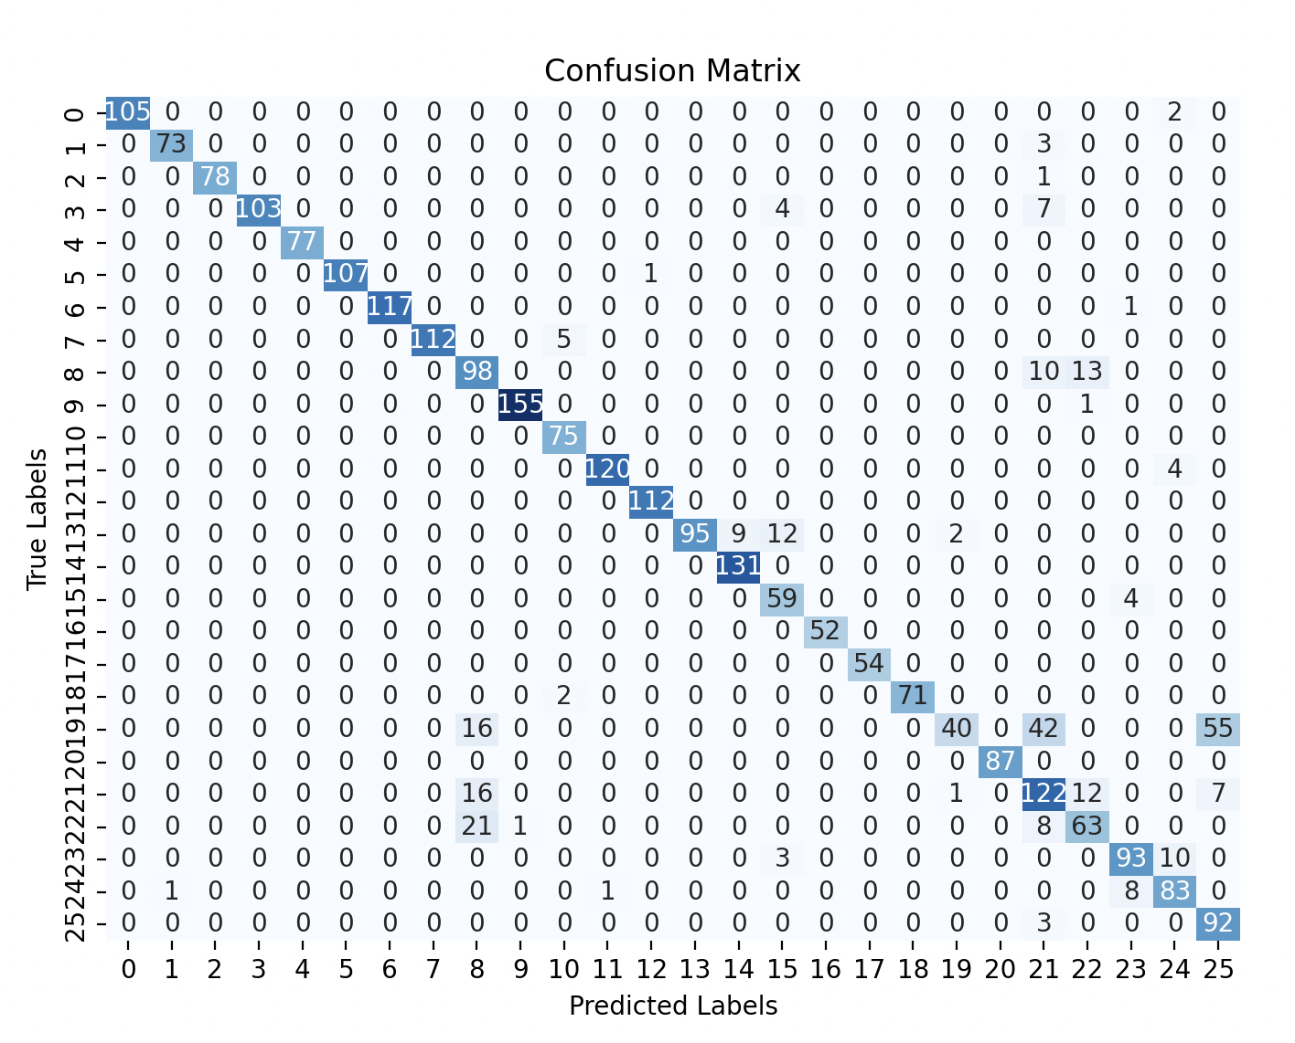
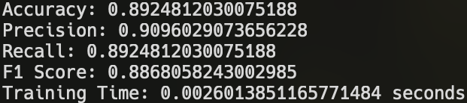
Results
These are the accuracy results of the machine learning model for letter translations.
For the control unit part, we have achieved a fairly high accuracy.
This allows the glove to translate with high precision.

Slide 15


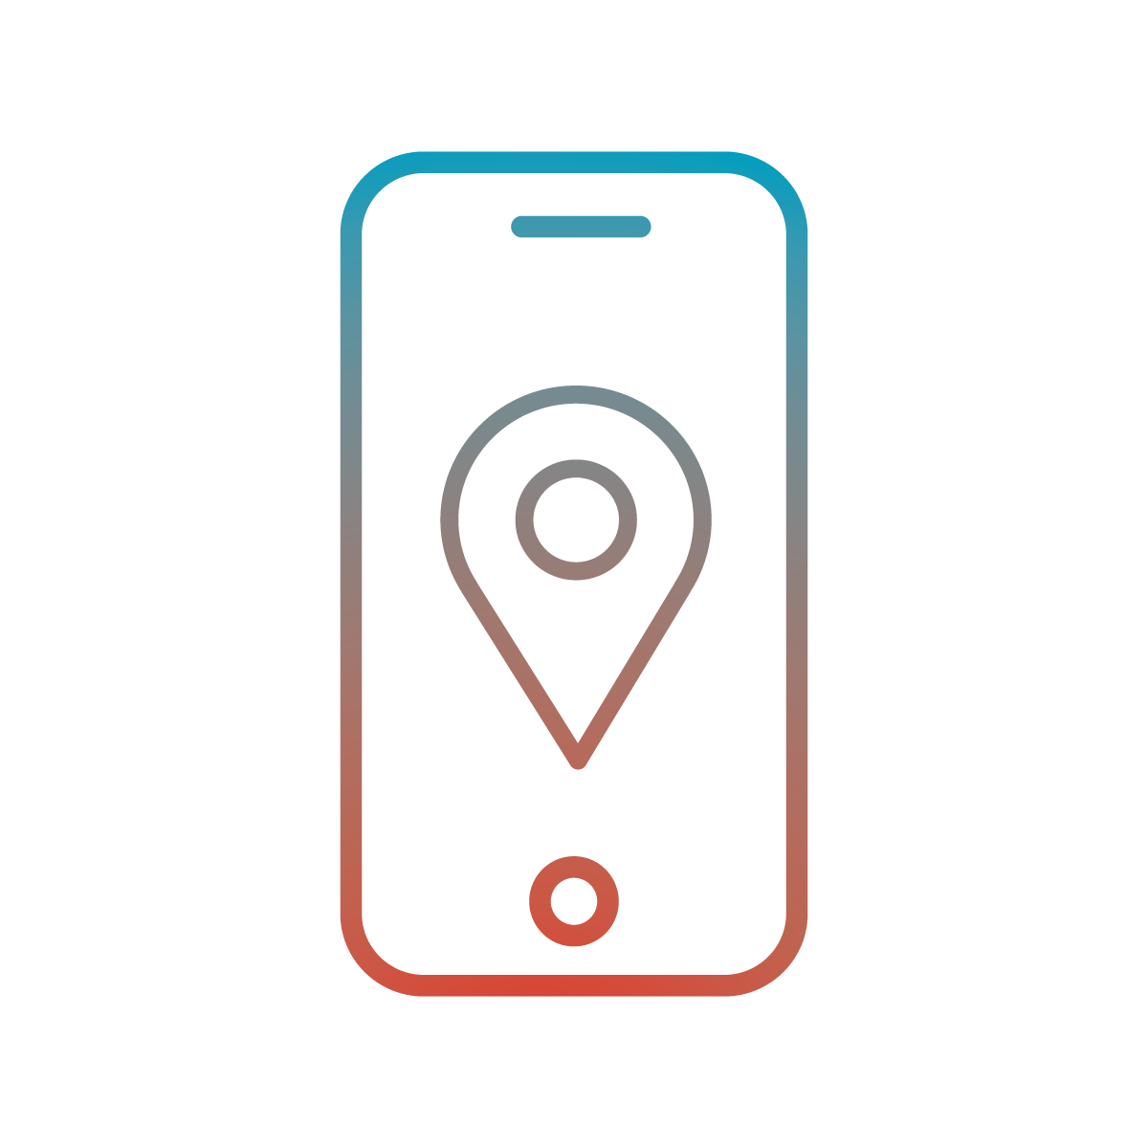
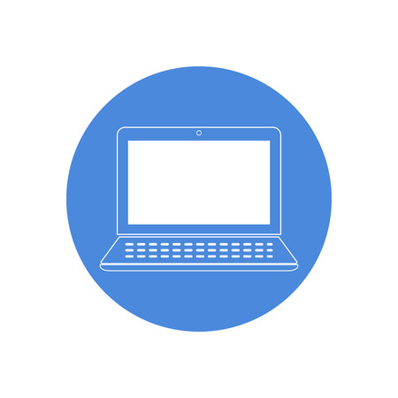

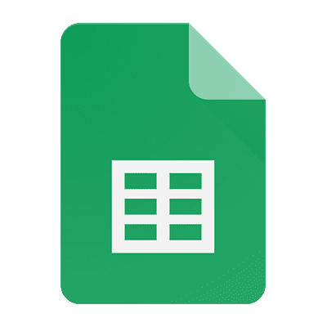


2 Cloud and communications
The communication between the devices occurs via MQTT and the use of a Database.
In particular, the implementation of a cloud solution and the mobile application aim to improve the safety and the accessibility of deaf people.
Mobile App
Web App
CouchDB
MQTT Broker
Mobile App
Google Sheets
Mobile App

Slide 16
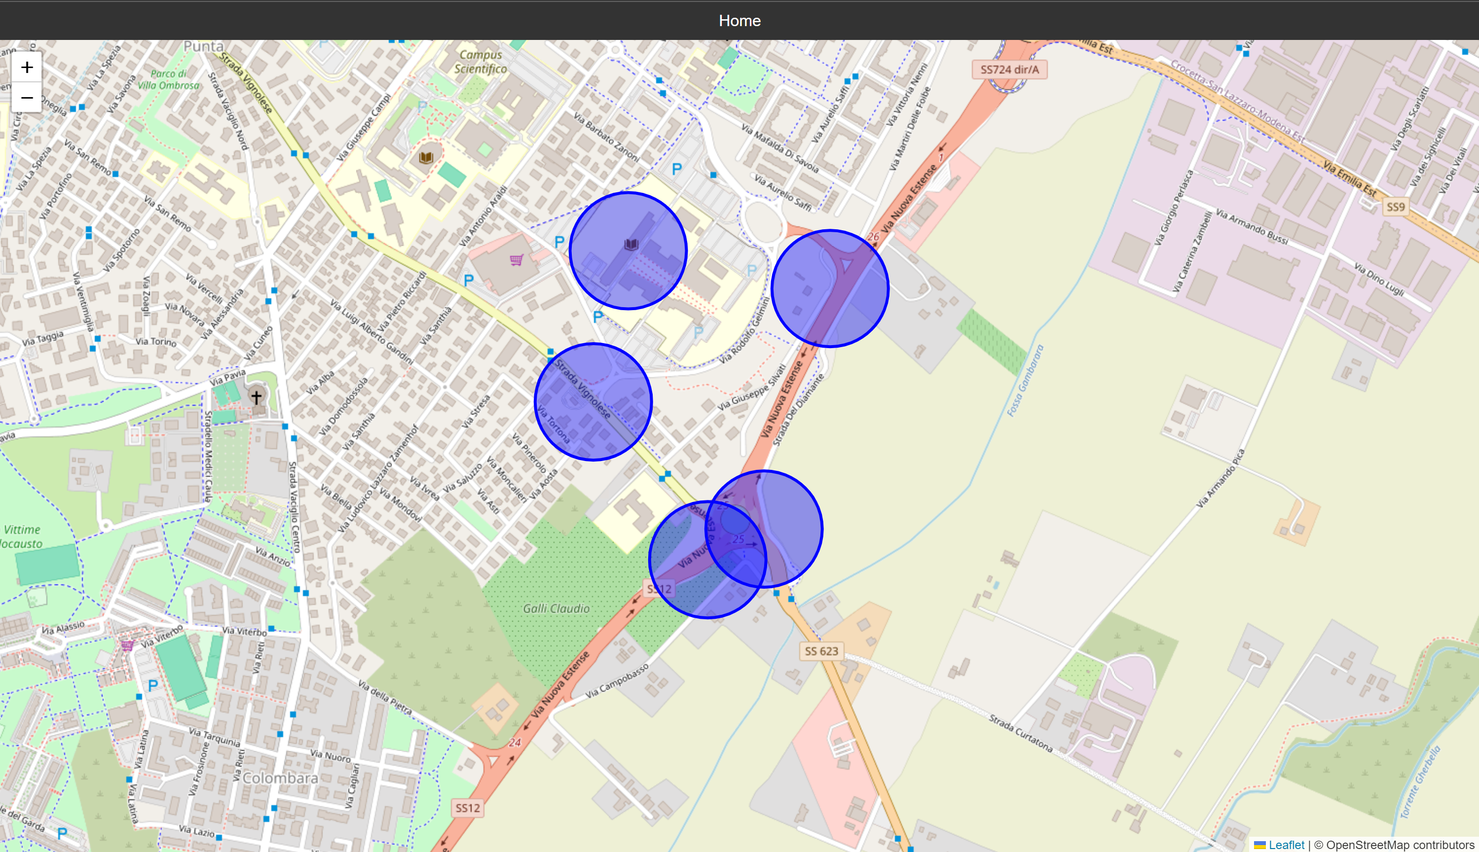
2.1 Web Application
The Web Application provides users with a general view of potentially hazardous areas.
Through the use of coordinates stored in the database, the app visualize dangerous zones on an interactive map.

Slide 17
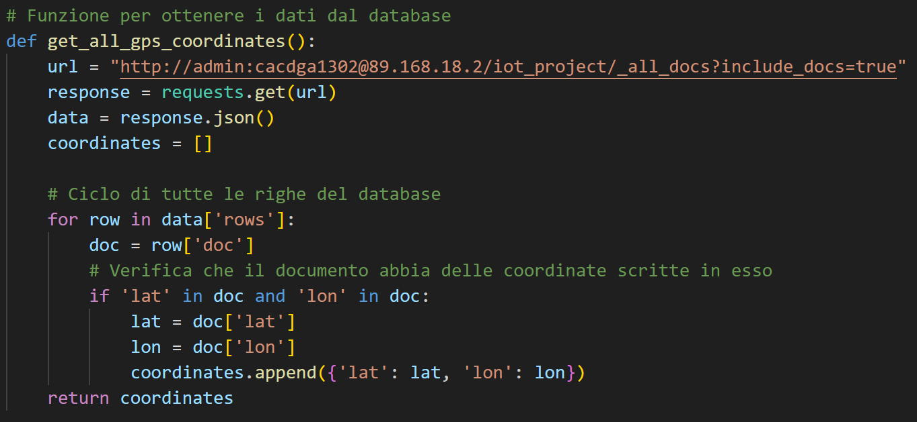
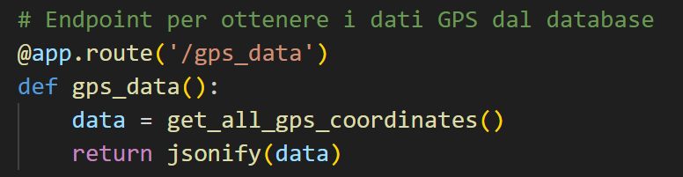
The app takes data from the database periodically, ensuring that the dangerous zones are always kept to date.
app.py

Slide 18
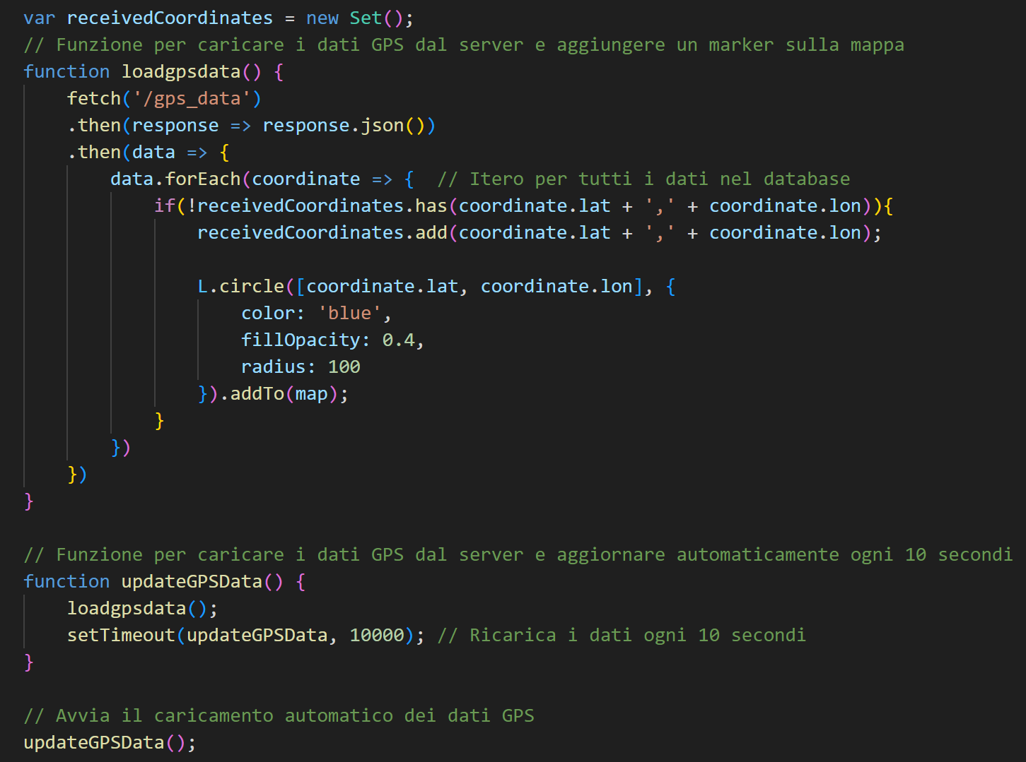
map.html

Slide 19
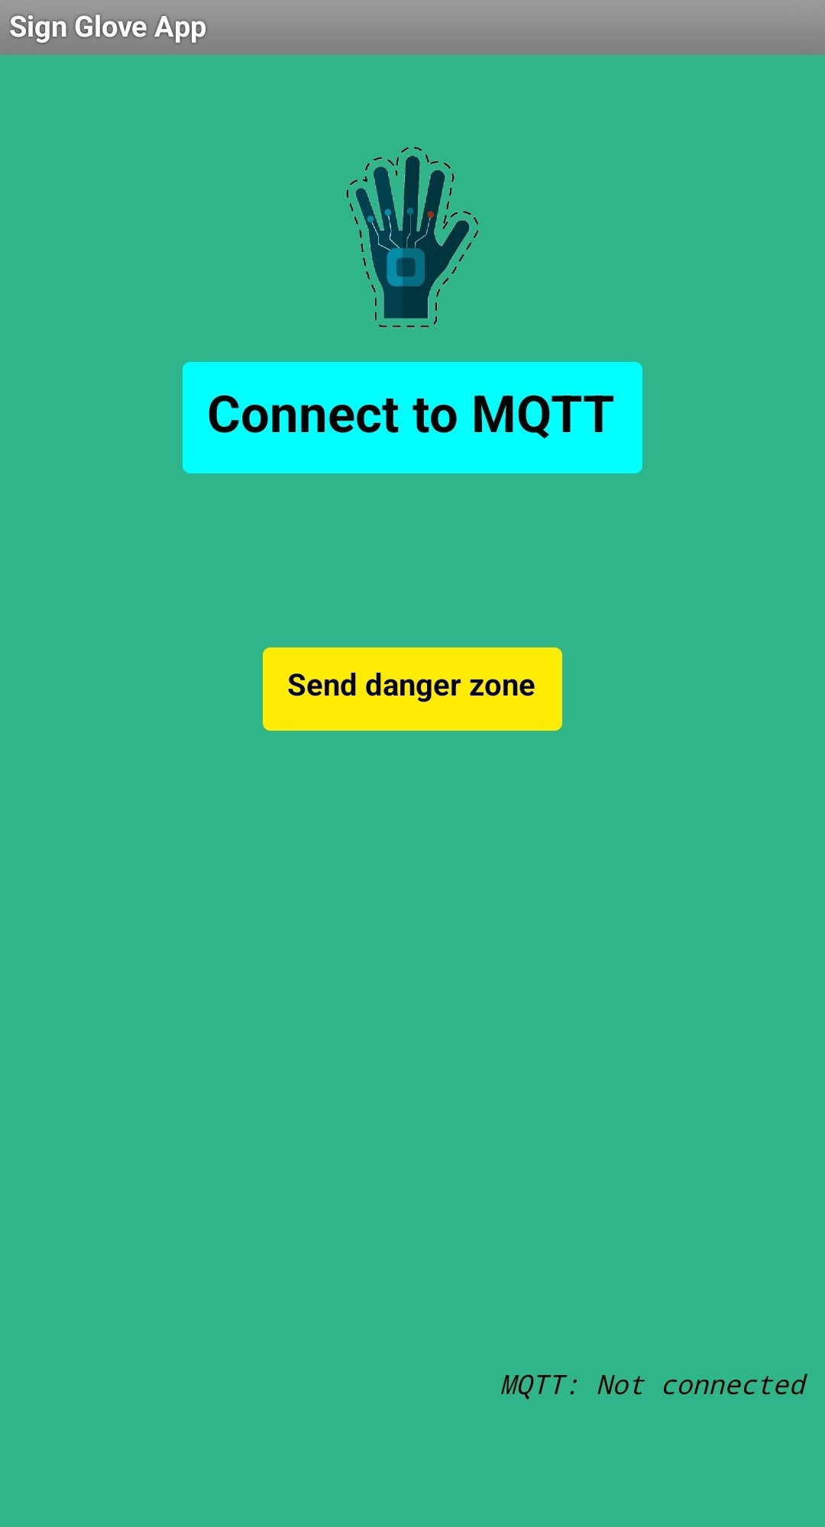
2.2 Mobile Application
Objective: Constantly monitor the user’s location and notify if entering a dangerous zone.
The Communication occurs via MQTT, where both the Broker and the devices work as both publishers and subscribers.
Also, it manages user credentials through the use of Google Sheets.

Slide 20
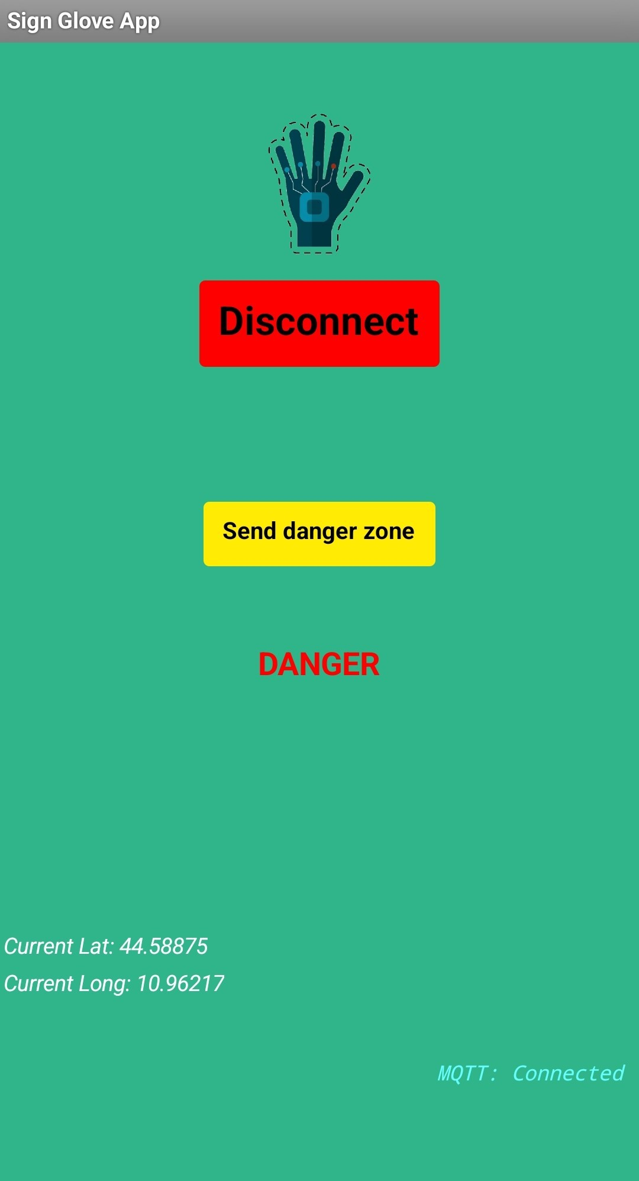
MQTT Communication:
The devices periodically send their current location to the MQTT Broker.
The MQTT Broker checks the received coordinates and sends a danger message if the user is in a hazardous zone.

Slide 21
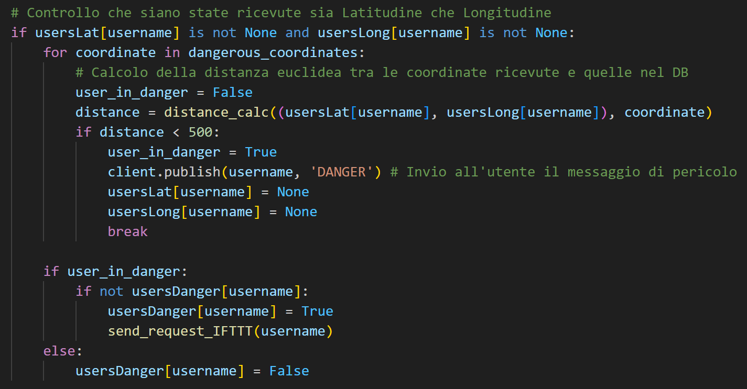
The MQTT Broker also sends a web request to IFTTT, which manages the notification system for the devices.

Slide 22
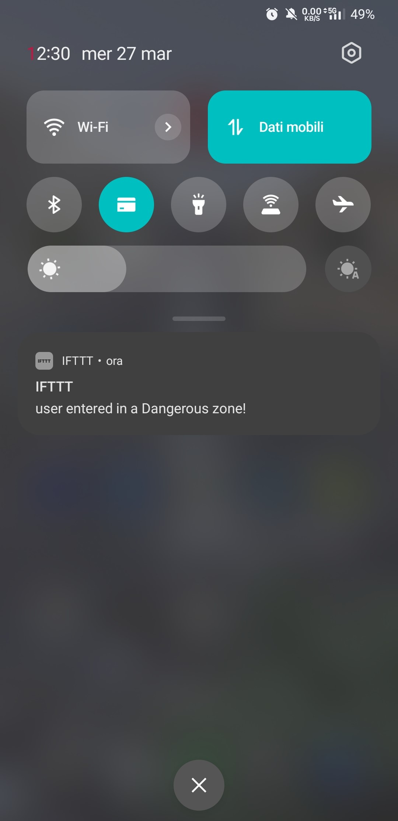
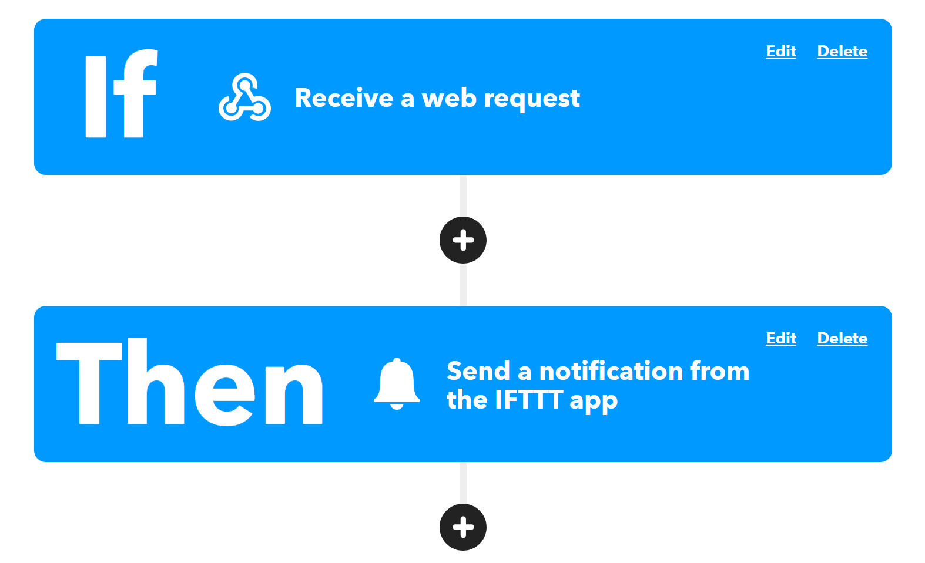
The MQTT Broker also sends a web request to IFTTT, which manages the notification system for the devices.

Slide 23
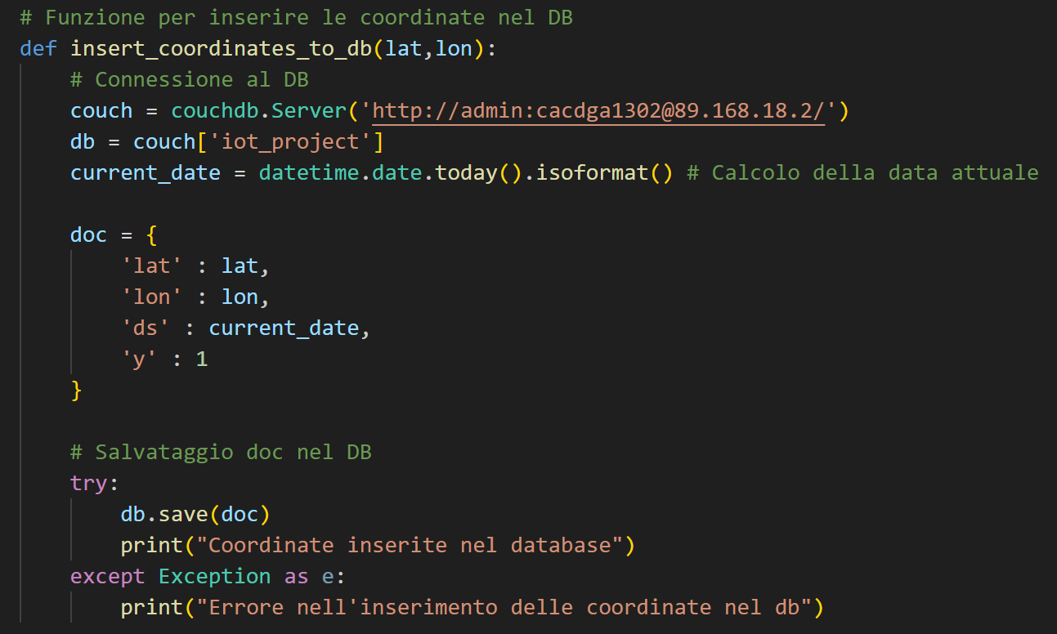
Another feature is the possibility to send a new dangerous location to the MQTT Broker, to be added to the CouchDB database.

Slide 24
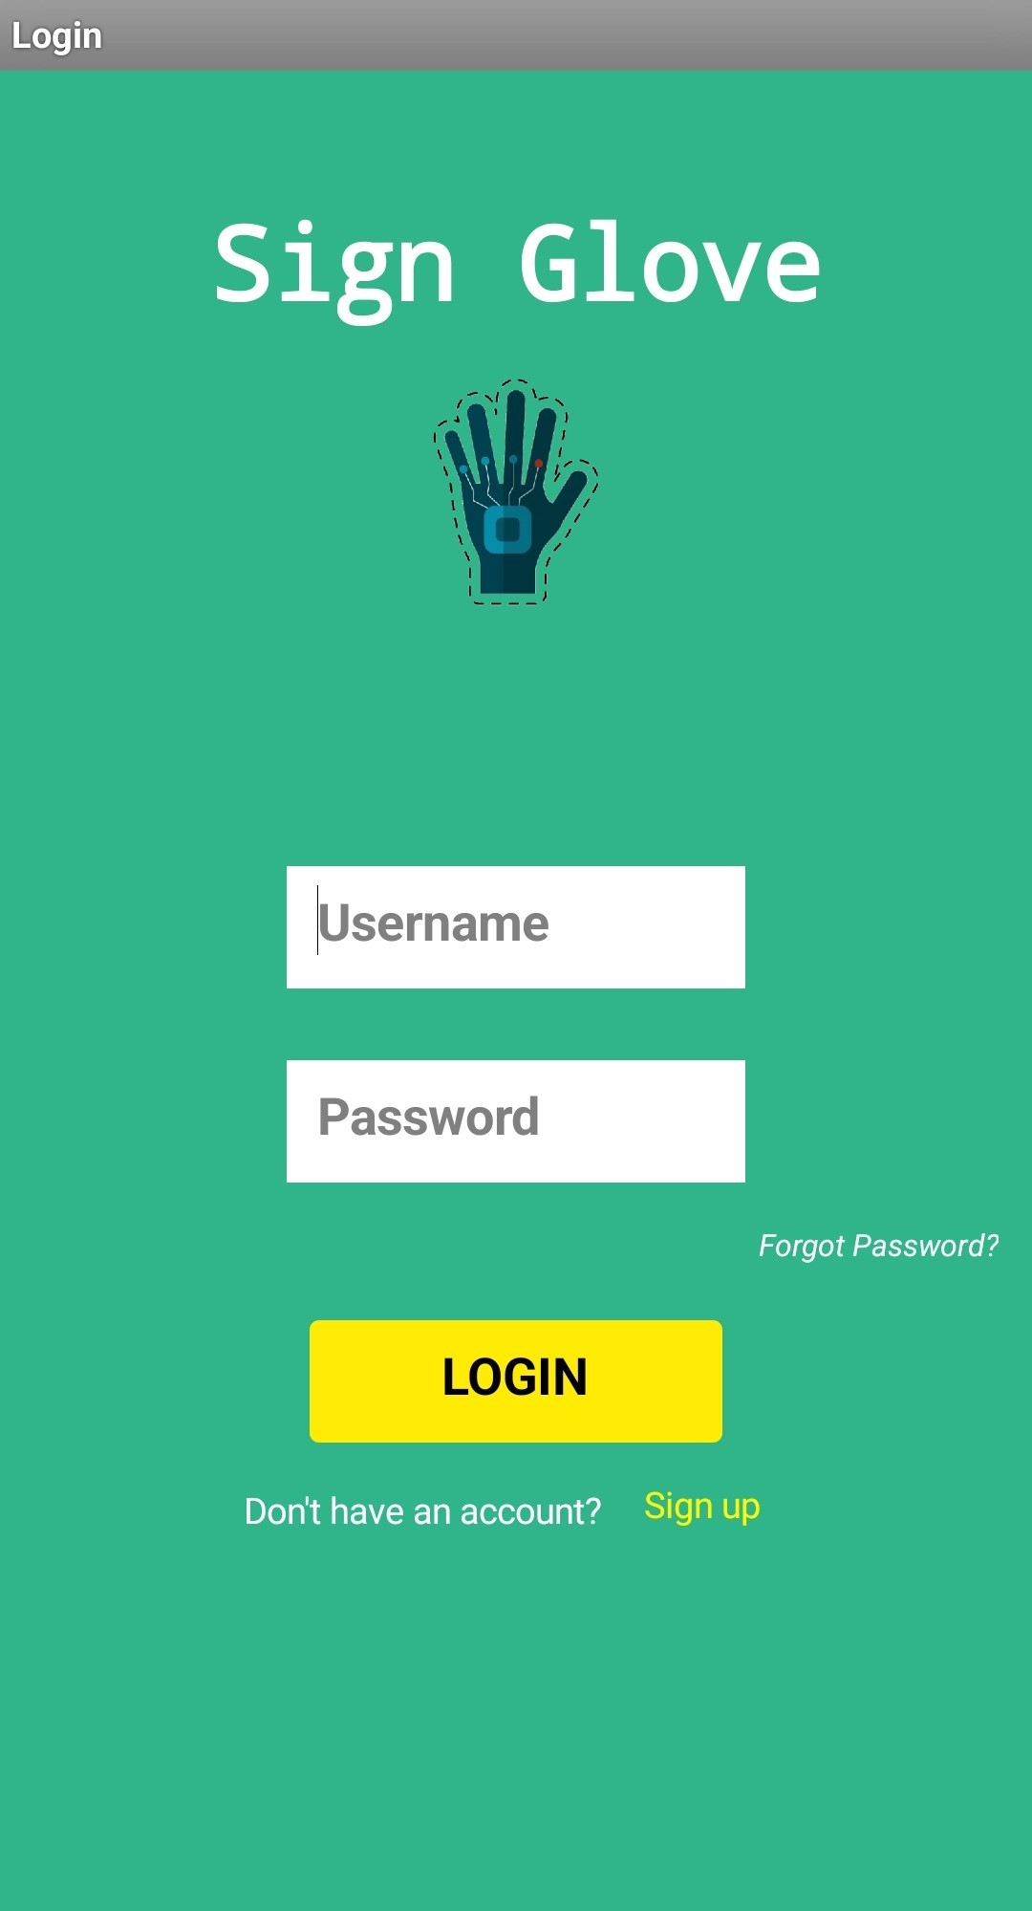
Credential management:
The App enables security and a controlled access, ensured by credential management, through the use of Google Sheets.

Slide 25
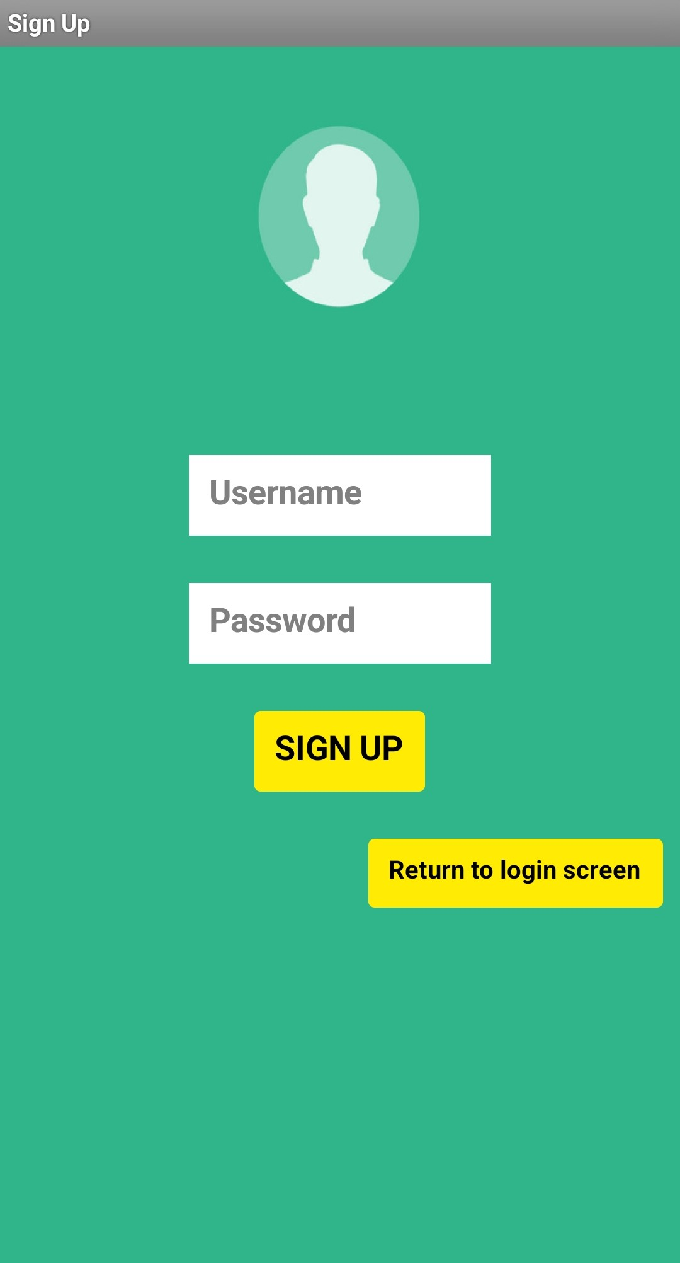
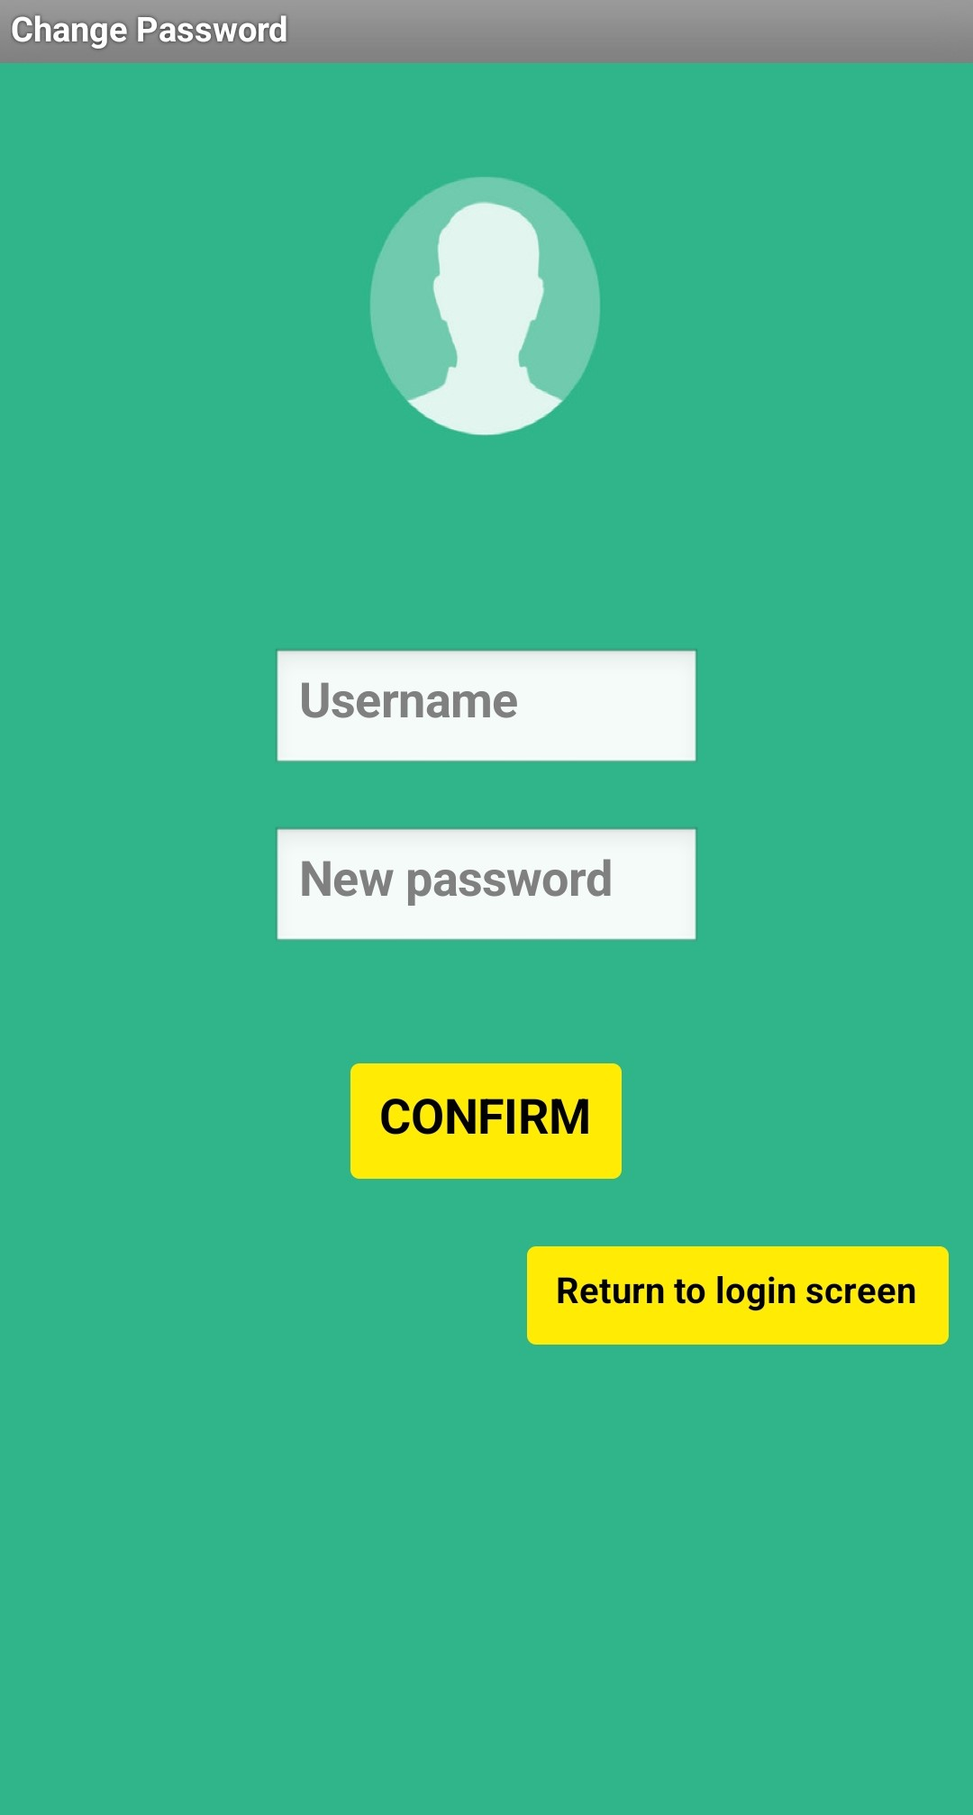

Slide 26
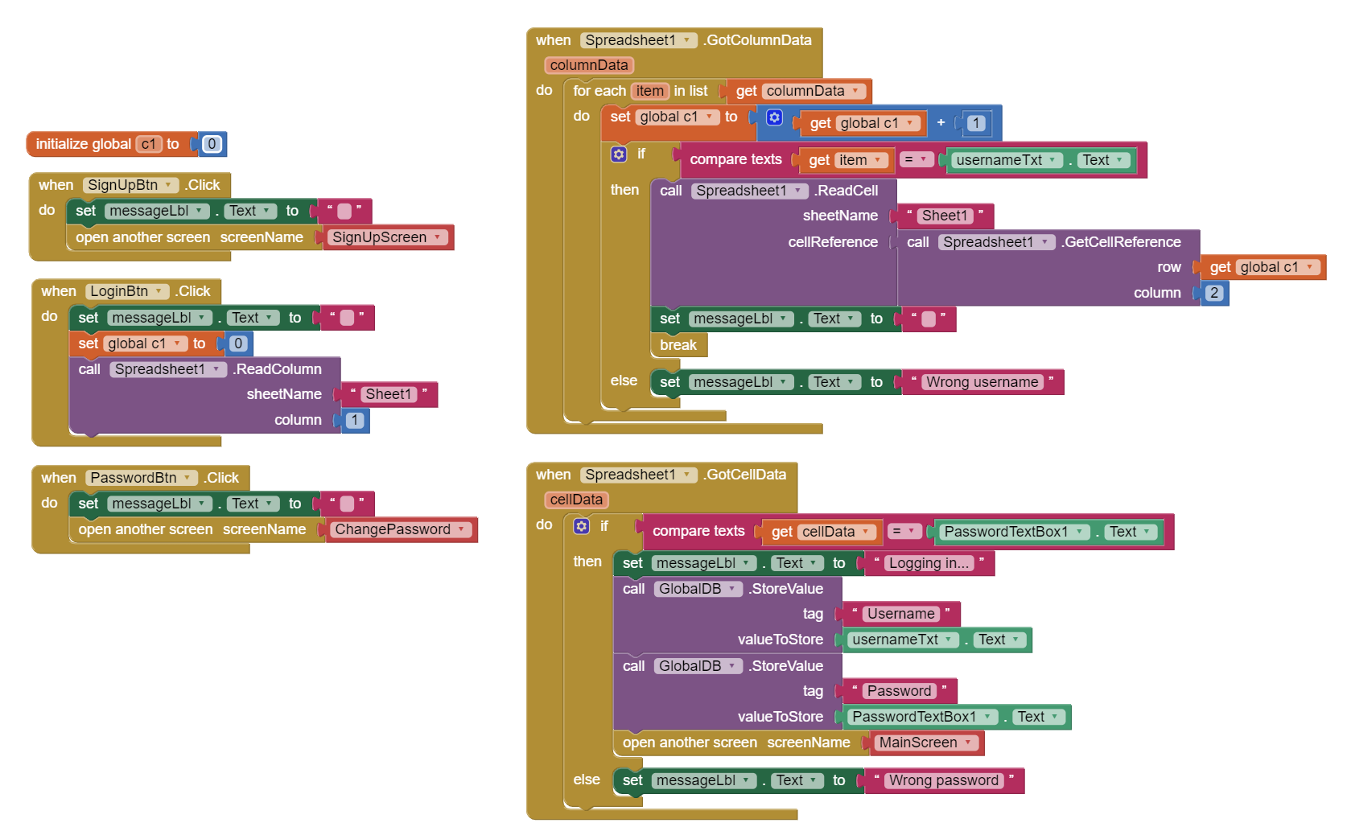
The entire Mobile Application was developed using MIT App Inventor:
Login Screen:

Slide 27
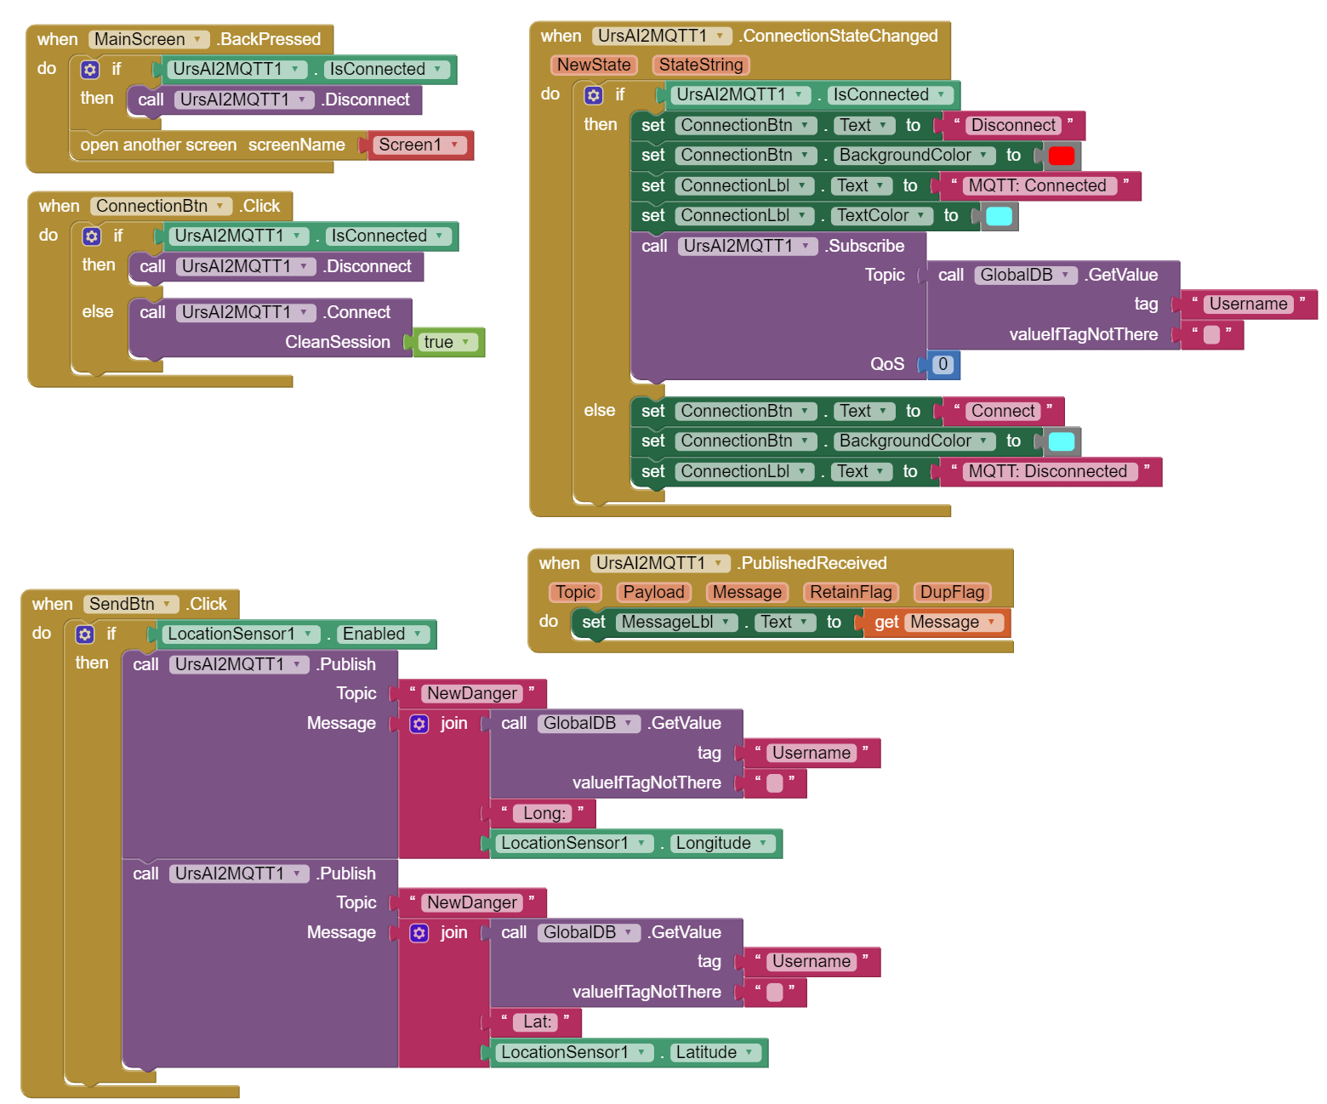
Main Screen (1):

Slide 28
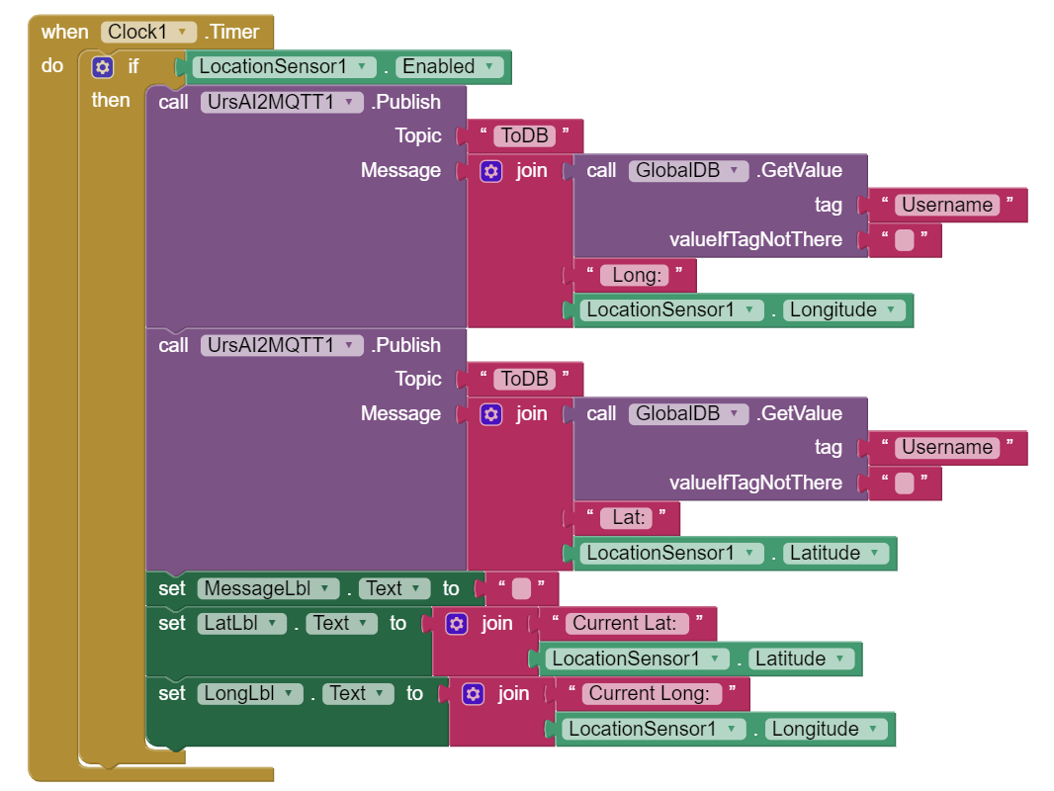
Main Screen (2):

Slide 29
3. Why do we need a warning prediction system?

Slide 30
3.1 Being voiceless it’s not that easy
Being deaf or mute can cause a lot of problems in modern life:
Isolated areas or with poor lighting
Areas with busy traffic or intersections
Events, construction sites, all places with loud sounds

Slide 31

3.2 Model
Using Prophet on time series, we can predict potential dangerous zones in Modena and show them in the map, by predicting the number of warning in a certain area.

Slide 32
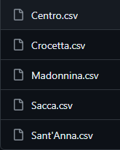
Dividing Modena in different neigborhoods, and training the model on all of them.
Then assigning the values in the corresponding database.

Slide 33
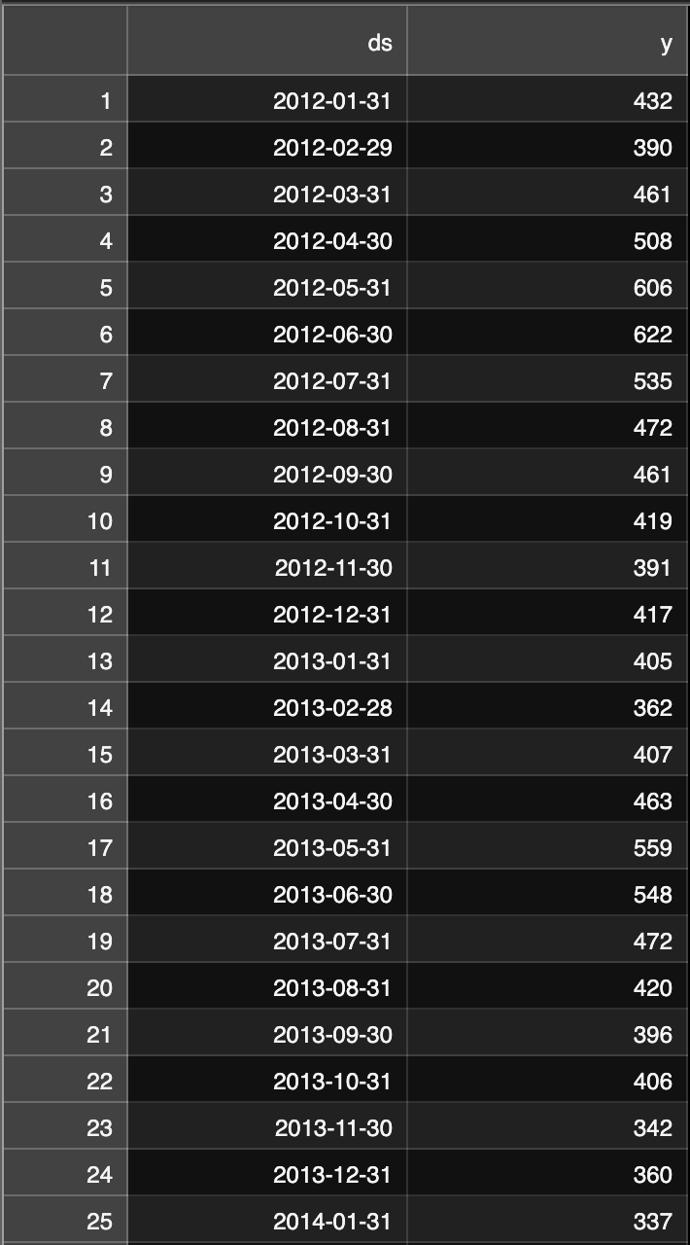
The database has 2 columns of interest, y and ds:
y: number of warnings
ds: the datetime

Slide 34
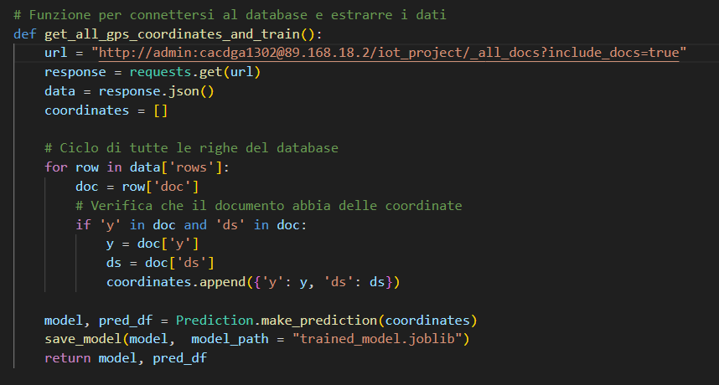
We train the model also on his predictions
And we do it monthly

Slide 35
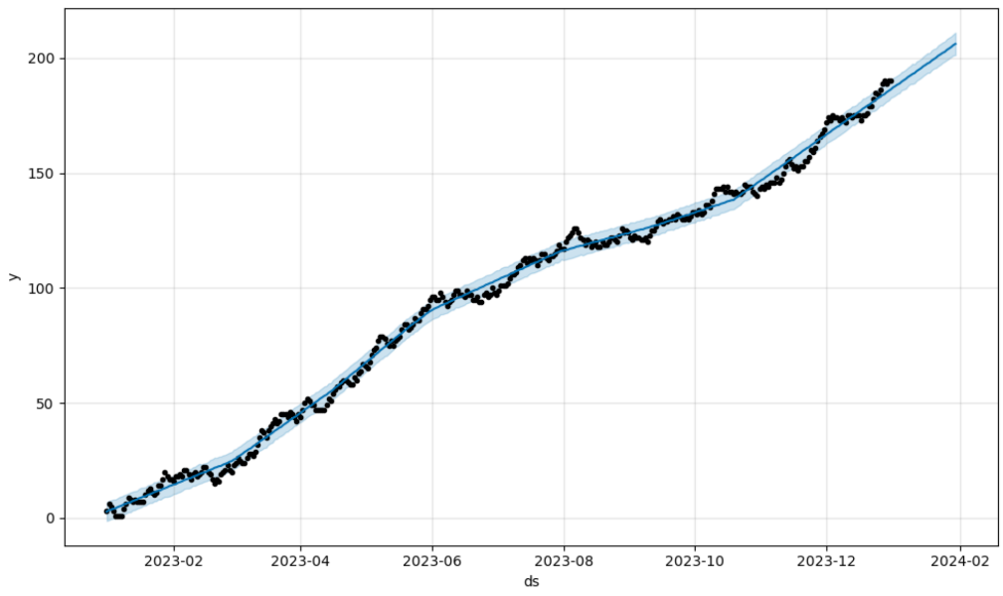
Points: real numbers
Blue line: it’s the predicted trend

Slide 36
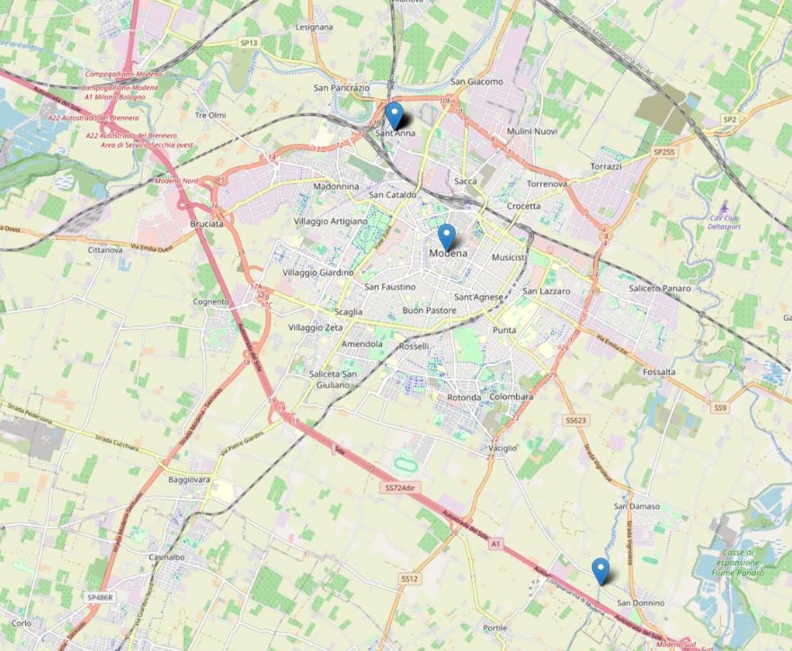
All dangerous zones are shown in the web app with blue pointers.

Slide 37
3.3 Possible improvements
In our society it’s a major problem to include minorities and promote equality.
Our project main goal it’s to work on that.
But there are a lot of improvements that can be made

Slide 38
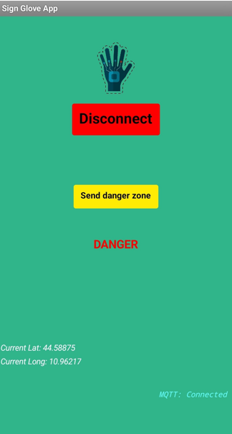
For example…
To help the accuracy of our prediction system, we added a button in the client app which everyone can use to set their location as dangerous, adding it to the database.

Slide 39
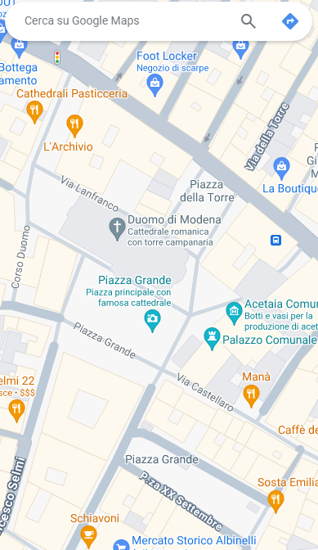
Or maybe, to help socialization, we can actually add a button that indicates for a limited time your position on the map, letting other people with the glove find you.
Ciao!

Slide 40
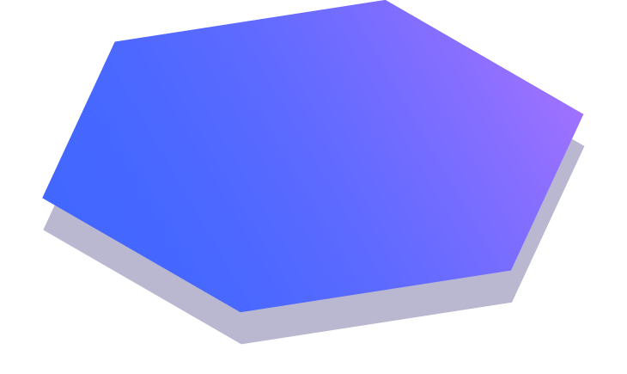
Thanks!

